Slide 1
3D Trick-Based Aerospace Simulation and Analysis of NASA Contractor-Relationships
Joey Muffoletto
Mrs. Angela Reeves
METECS, Johnson Space Center
Mrs. Kathy Thiessen
*Some of this information for this presentation came from outside sources

Slide 2
What is the Product?
Aerospace Simulations (METECS)
Trick-Based Simulations
Blender

Slide 3
Project Overview
Completion of every goal
SpaceX Falcon 9 FT (v1.2) simulation
Simulated Using NASA’s Trick Simulation Software
Visualized using 3D model in Blender

Slide 4
Process
Gathering data on Falcon 9 FT
Creating assumptions for use in simulation
Basic outline using OneNote
Writing the simulation in Trick
3D model creation using Blender
Playback integration using Trick DRGs and Blender Python-based scripting

Slide 5
Assumptions for Simulation
Falcon 9 FT LEO “Simulation”
Only stage 1 of flight simulated
Data taken from launch telemetry and specifications released by SpaceX
Extensive list of assumptions
Missed expectations
Purpose of creating this simulation changed throughout the process
Notes:
Address all assumptions, address which trajectory you chose LEO C, talk about how its not really a simulation I guess, math too hard, more of a showcase of Trick abilities

Slide 6
Creation of Simulation in Trick
Applied what I learned from initial cannon simulation
Base movement completed and driven solely by thrust
Additional complexity added after initial testing was successful
Altitude + Air Density
Fuel Mass + Burn time
Angle
Drag
Data recording groups
Issues with Trick environment on Windows

Slide 7
3D Modelling in Blender
Diagrams taken from various online sources
5 to 1 scale to allow for easier manipulation within the Blender environment
UV mapping the rocket’s livery
Creation of engine with accompanying normal map
Flames created using wave modifiers on a cone + diffuse node set to volume

Slide 8
Playback in Blender
Saving data using the Trick DRGs into a csv
Import data into Blender using the built in scripting environment
Basic script in Python to implement location and angle
Keyframes, playback of position data essentially (.1 second interval, 1620 keyframes)
Additional keyframes for a bit more realism in the playback

Slide 9
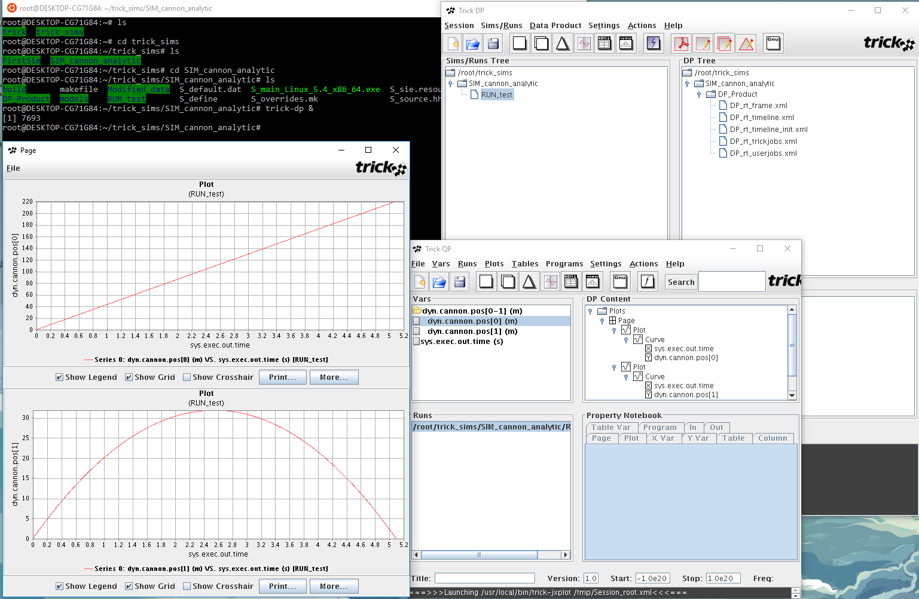
Product Photos
Sample Trick Interface with accompanying GUI elements (taken from my desktop)

Slide 10
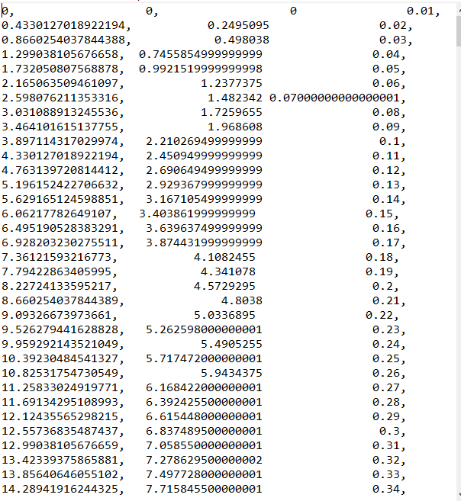
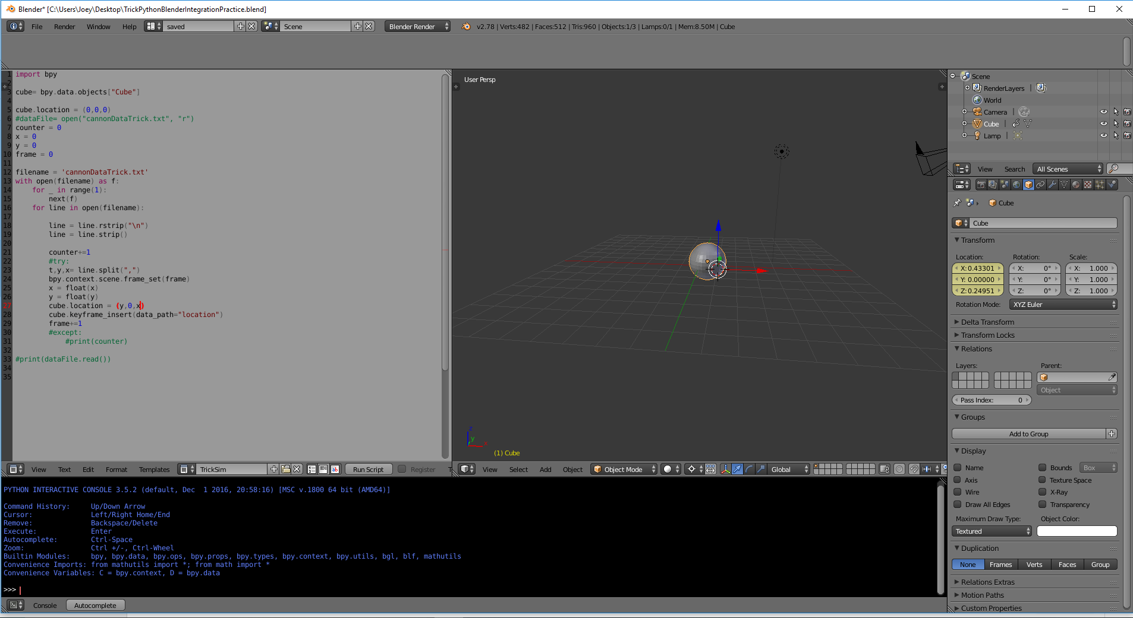
Product Photos
Blender Environment with Cannonball
Part of the Position-Time Data from the Trick Sim

Slide 11
Future Plans for Complexity
More variables of flight¹
Continue investigation of real-time integration between Trick and Blender
Sourcing For Flight Variable Information:
United States, Congress, Scientific and Technical Information Office, and Theodore A Talay. “Introduction to the Aerodynamics of Flight.” Introduction to the Aerodynamics of Flight, Langley Research Center, 1975, pp. 1–135.

Slide 12
Business Aspect
NASA Contractor Relationships²
METECS
² United States, Congress, Low Cost Systems Office and Procurement Office, and Joseph P. Guiltinan. “CONTRACTOR RELATIONSHIPS AND INTER-ORGANIZATIONAL STRATEGIES IN NASA's R&D ACQUISITION PROCESS.” NASA Archives, NASA-Headquarters, 1976, pp. 1–25.

Slide 13
Why Software Simulations?
Computers
Future Potential of the Field

Slide 14
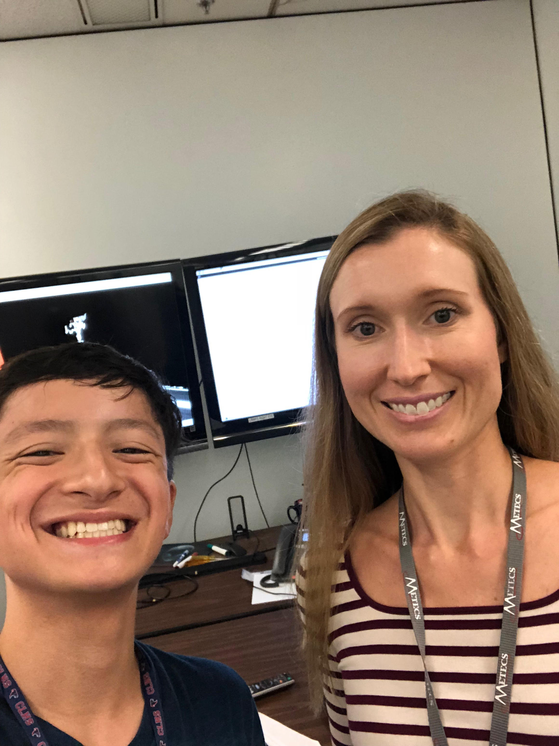
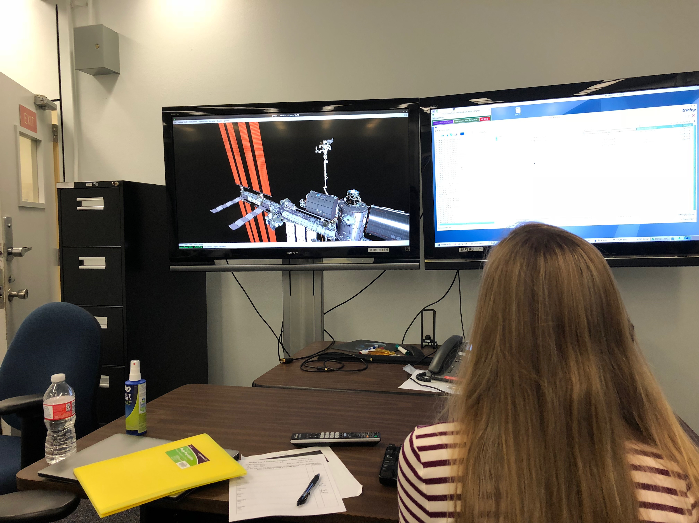
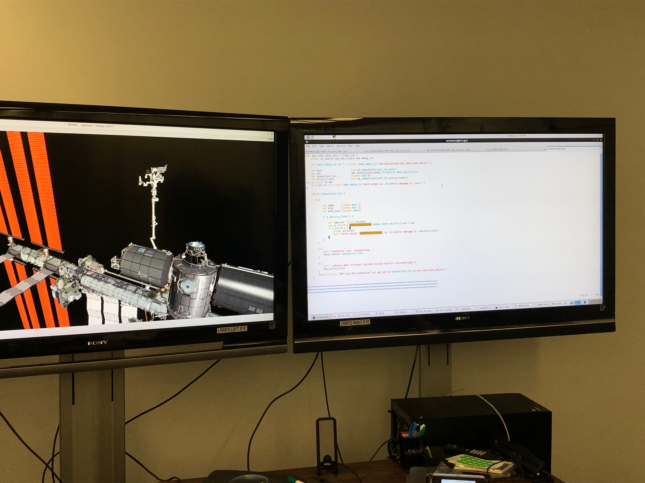
Mentorship Photos
Presentation Area used for demonstrations (such as the TS21 ISS Simulation with DOUG graphics)
My Mentor and I in building 16 at JSC

Slide 15
References
² United States, Congress, Low Cost Systems Office and Procurement Office, and Joseph P. Guiltinan. “CONTRACTOR RELATIONSHIPS AND INTER-ORGANIZATIONAL STRATEGIES IN NASA's R&D ACQUISITION PROCESS.” NASA Archives, NASA-Headquarters, 1976, pp. 1–25.
¹ United States, Congress, Scientific and Technical Information Office, and Theodore A Talay. “Introduction to the Aerodynamics of Flight.” Introduction to the Aerodynamics of Flight, Langley Research Center, 1975, pp. 1–135.

Slide 16
Questions?

Slide 17
Thank You For Your Time!
Special thanks to Mrs. Angela Reeves for mentoring me, Mrs. Thiessen for facilitating such a wonderful opportunity, and my parents for supporting me through this endeavor.

